Slide 1




Slide 2
BC0 008B Operating Systems Course PPT
Unit-II
Submitted By
Ruchi Kulshrestha

Slide 3
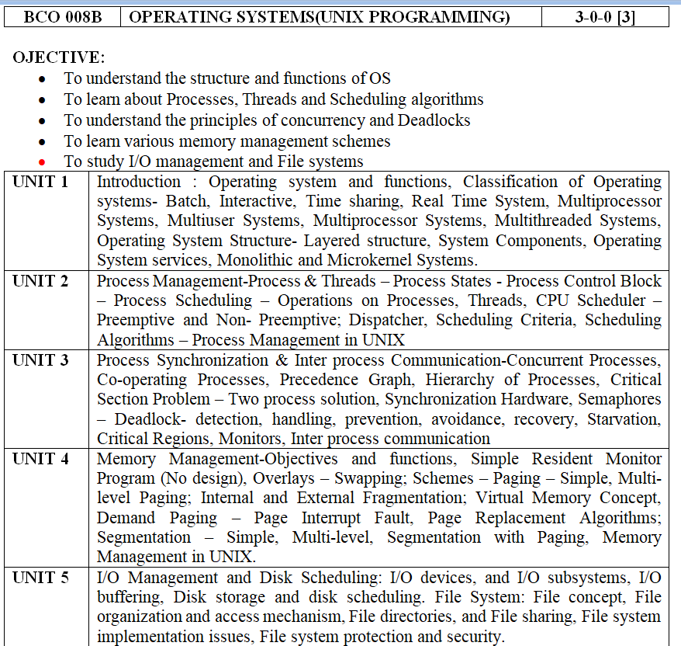

Slide 4
Text Books:
1. Operating Systems Concepts – Silberschatz, Galvin, Wiley Publications (2008)
2. Modern Operating Systems - Andrew S. Tanenbaum, Pearson Education Asia / PHI(2005)
Reference Books:
Operating Systems – William Stallings, Pearson Education Asia (2002)
UNIX System Programming Using C++, by Terrence Chan: Prentice Hall India, 1999.
Advanced Programming in UNIX Environment, by W. Richard Stevens: 2nd Ed, Pearson Education, 2005

Slide 5
Course Outcome (CO):
At the ends of this course studentswill have:
CO1: Classify Unix Kernel mode with user mode & contrast between Kernel structures.
CO2: Identify and estimate process management & thread management strategies along with their different operations
CO3: Implement deadlock and different system calls for various file handling operations.
CO4: Determine Paging and Caching techniques related to Virtual Memory.

Slide 6
Mapping of COs with Pos
MAPPING COURSE OUTCOMES LEADING TO THE ACHIEVEMENT OF
PROGRAM OUTCOMES AND PROGRAM SPECIFIC OUTCOMES:
Course Outcome | Program Outcome |  |  |  |  |  |  |  |  |  |  |  | Program Specifice Outcome
 | PO1 | PO2 | PO3 | PO4 | PO5 | PO6 | PO7 | PO8 | PO9 | PO10 | PO11 | PO12 | PSO1 | PSO2 | PSO3
CO1 | H |  |  | M |  |  |  | L |  |  | L |  | H |  | L
CO2 |  | M | L |  |  |  |  |  | M |  |  |  |  | M
CO3 |  |  | M |  | M |  |  |  |  |  |  |  |  | M | M
CO4 | M |  | L |  |  |  |  |  |  |  |  | L
H = Highly Related; M = Medium L = Low

Slide 7
Interprocess Communication
Processes within a system may be independent or cooperating
Cooperating process can affect or be affected by other processes, including sharing data
Reasons for cooperating processes:
Information sharing
Computation speedup
Modularity
Convenience
Cooperating processes need interprocess communication (IPC)
Two models of IPC
Shared memory
Message passing

Slide 8
Communications Models
(a) Message passing. (b) shared memory.

Slide 9
Cooperating Processes
Independent process cannot affect or be affected by the execution of another process
Cooperating process can affect or be affected by the execution of another process
Advantages of process cooperation
Information sharing
Computation speed-up
Modularity
Convenience

Slide 10
Producer-Consumer Problem
Paradigm for cooperating processes, producer process produces information that is consumed by a consumer process
unbounded-buffer places no practical limit on the size of the buffer
bounded-buffer assumes that there is a fixed buffer size

Slide 11
Bounded-Buffer – Shared-Memory Solution
Shared data
#define BUFFER_SIZE 10
typedef struct {
. . .
} item;
item buffer[BUFFER_SIZE];
int in = 0;
int out = 0;
Solution is correct, but can only use BUFFER_SIZE-1 elements

Slide 12
Bounded-Buffer – Producer
item next_produced;
while (true) {
/* produce an item in next produced */
while (((in + 1) % BUFFER_SIZE) == out)
; /* do nothing */
buffer[in] = next_produced;
in = (in + 1) % BUFFER_SIZE;
}

Slide 13
Bounded Buffer – Consumer
item next_consumed;
while (true) { while (in == out)
; /* do nothing */ next_consumed = buffer[out];
out = (out + 1) % BUFFER_SIZE;
/* consume the item in next consumed */
}

Slide 14
Interprocess Communication – Shared Memory
An area of memory shared among the processes that wish to communicate
The communication is under the control of the users processes not the operating system.
Major issues is to provide mechanism that will allow the user processes to synchronize their actions when they access shared memory.
Synchronization is discussed in great details in Chapter 5.

Slide 15
Interprocess Communication – Message Passing
Mechanism for processes to communicate and to synchronize their actions
Message system – processes communicate with each other without resorting to shared variables
IPC facility provides two operations:
send(message)
receive(message)
The message size is either fixed or variable

Slide 16
Message Passing (Cont.)
If processes P and Q wish to communicate, they need to:
Establish a communication link between them
Exchange messages via send/receive
Implementation issues:
How are links established?
Can a link be associated with more than two processes?
How many links can there be between every pair of communicating processes?
What is the capacity of a link?
Is the size of a message that the link can accommodate fixed or variable?
Is a link unidirectional or bi-directional?

Slide 17
Message Passing (Cont.)
Implementation of communication link
Physical:
Shared memory
Hardware bus
Network
Logical:
Direct or indirect
Synchronous or asynchronous
Automatic or explicit buffering

Slide 18
Direct Communication
Processes must name each other explicitly:
send (P, message) – send a message to process P
receive(Q, message) – receive a message from process Q
Properties of communication link
Links are established automatically
A link is associated with exactly one pair of communicating processes
Between each pair there exists exactly one link
The link may be unidirectional, but is usually bi-directional

Slide 19
Indirect Communication
Messages are directed and received from mailboxes (also referred to as ports)
Each mailbox has a unique id
Processes can communicate only if they share a mailbox
Properties of communication link
Link established only if processes share a common mailbox
A link may be associated with many processes
Each pair of processes may share several communication links
Link may be unidirectional or bi-directional

Slide 20
Indirect Communication
Operations
create a new mailbox (port)
send and receive messages through mailbox
destroy a mailbox
Primitives are defined as:
send(A, message) – send a message to mailbox A
receive(A, message) – receive a message from mailbox A

Slide 21
Indirect Communication
Mailbox sharing
P₁, P₂, and P₃ share mailbox A
P₁, sends; P₂ and P₃ receive
Who gets the message?
Solutions
Allow a link to be associated with at most two processes
Allow only one process at a time to execute a receive operation
Allow the system to select arbitrarily the receiver. Sender is notified who the receiver was.

Slide 22
Synchronization
Message passing may be either blocking or non-blocking
Blocking is considered synchronous
Blocking send -- the sender is blocked until the message is received
Blocking receive -- the receiver is blocked until a message is available
Non-blocking is considered asynchronous
Non-blocking send -- the sender sends the message and continue
Non-blocking receive -- the receiver receives:
A valid message, or
Null message
Different combinations possible
If both send and receive are blocking, we have a rendezvous

Slide 23
Synchronization (Cont.)
Producer-consumer becomes trivial
message next_produced;
while (true) { /* produce an item in next produced */
send(next_produced);
}
message next_consumed;
while (true) {
receive(next_consumed);
/* consume the item in next consumed */
}

Slide 24
Buffering
Queue of messages attached to the link.
implemented in one of three ways
1. Zero capacity – no messages are queued on a link. Sender must wait for receiver (rendezvous)
2. Bounded capacity – finite length of n messages Sender must wait if link full
3. Unbounded capacity – infinite length Sender never waits

Slide 25
Examples of IPC Systems - POSIX
POSIX Shared Memory
Process first creates shared memory segment shm_fd = shm_open(name, O CREAT | O RDWR, 0666);
Also used to open an existing segment to share it
Set the size of the object
ftruncate(shm fd, 4096);
Now the process could write to the shared memory
sprintf(shared memory, "Writing to shared memory");

Slide 26
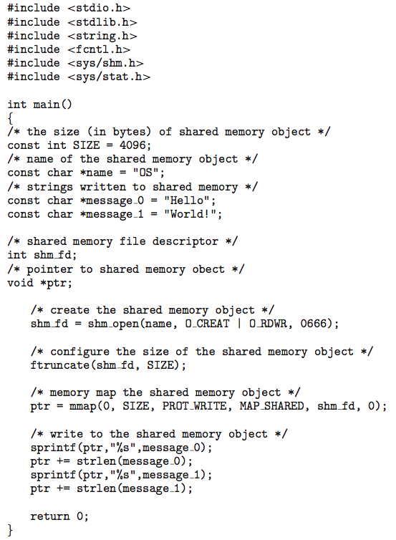
IPC POSIX Producer

Slide 27
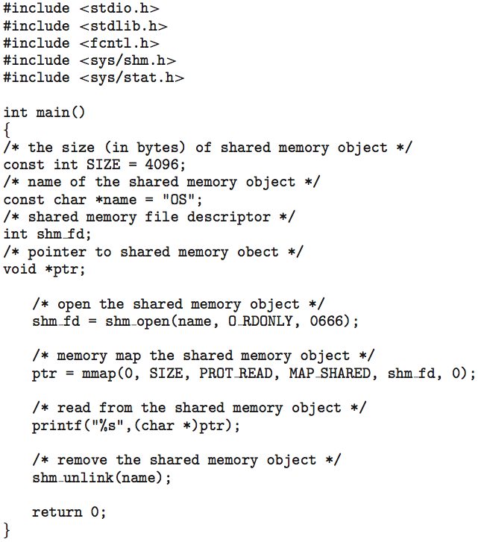
IPC POSIX Consumer

Slide 28
Examples of IPC Systems - Mach
Mach communication is message based
Even system calls are messages
Each task gets two mailboxes at creation- Kernel and Notify
Only three system calls needed for message transfer
msg_send(), msg_receive(), msg_rpc()
Mailboxes needed for commuication, created via
port_allocate()
Send and receive are flexible, for example four options if mailbox full:
Wait indefinitely
Wait at most n milliseconds
Return immediately
Temporarily cache a message

Slide 29
Examples of IPC Systems – Windows
Message-passing centric via advanced local procedure call (LPC) facility
Only works between processes on the same system
Uses ports (like mailboxes) to establish and maintain communication channels
Communication works as follows:
The client opens a handle to the subsystem’s connection port object.
The client sends a connection request.
The server creates two private communication ports and returns the handle to one of them to the client.
The client and server use the corresponding port handle to send messages or callbacks and to listen for replies.

Slide 30
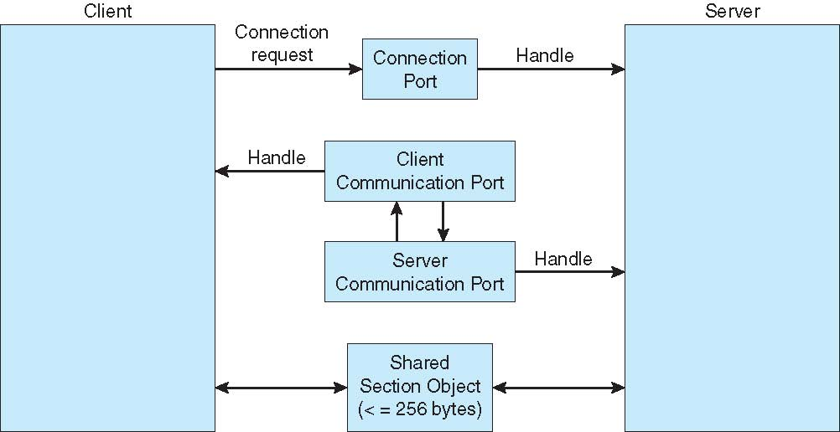
Local Procedure Calls in Windows

Slide 31
Communications in Client-Server Systems
Sockets
Remote Procedure Calls
Pipes
Remote Method Invocation (Java)

Slide 32
What is deadlock?
In an operating system a deadlock is a situation which occurs when a process or thread enters a waiting state because a resource requested is being held by another waiting process, which in turn is waiting for another resource held by another waiting process. If a process is unable to change its state indefinitely because the resources requested by it are being used by another waiting process, then the system is said to be in a deadlock.

Slide 33
Necessary conditions
ALL of these four must happen simultaneously for a deadlock to occur:
Mutual exclusion
At least one must be held by a process in a non-sharable (exclusive) mode.
Hold and Wait
A process holds a resource while waiting for another resource.
No Preemption
A process can release the resource held by it only when it complete its task.
Circular Wait
A set of waiting processes { P0, P1, P2 ………Pn} must exist such that process P0 is waiting for resource held by P1, P1 is waiting for resource held by P2, P2 is waiting for resource held by P3 and so on and the process Pn is waiting for resource held by P0.

Slide 34
Resource Allocation Graph
This is a visual ( mathematical ) way to determine if a deadlock has, or may occur.
The graph contains nodes and edges in the form G=(V, E).
V Nodes consist of processes = { P1, P2, P3, ...} and resource types
{ R1, R2, ...}
E Edges are ( Pi, Rj ) or ( Ri, Pj )
An arrow from the process to resource indicates the process is requesting the resource. An arrow from resource to process shows an instance of the resource has been allocated to the process.
Process is a circle, resource type is square; dots represent number of instances of resource in type. Request points to square, assignment comes from dot.

Slide 35
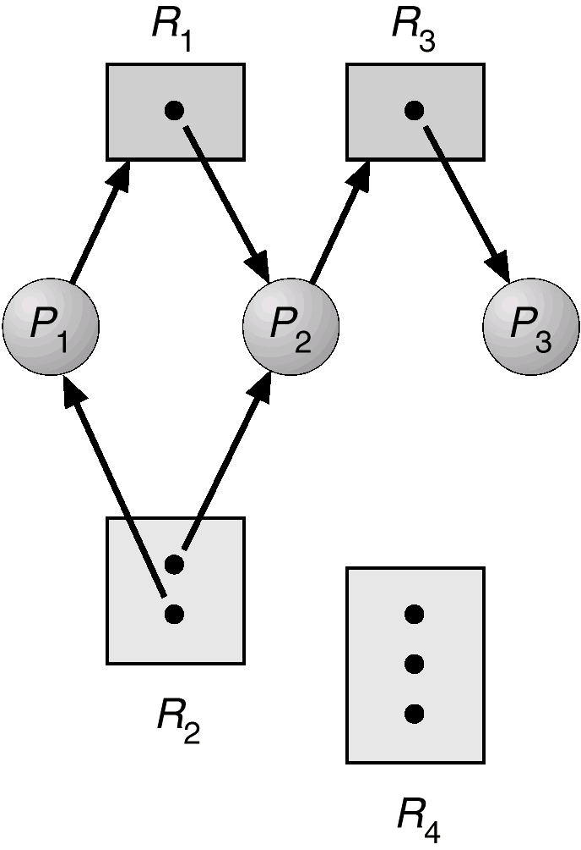
If graph doesn’t have any cycle then deadlock is not occurred. But if there is any cycle then deadlock may occur.
R3 Assigned to P3
P2 Requests R3

Slide 36
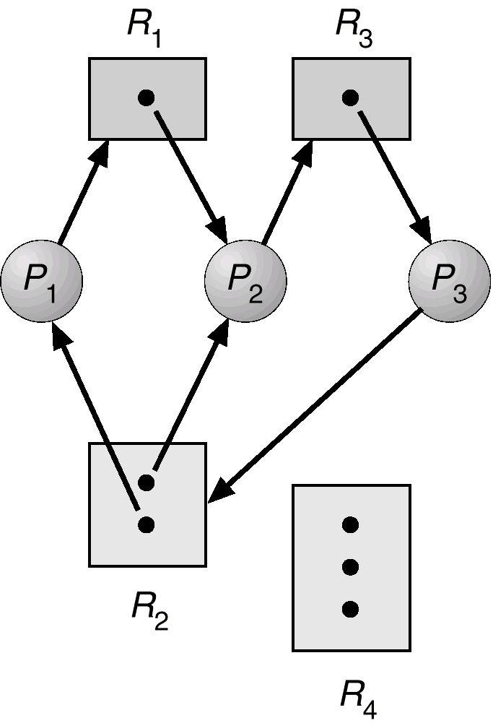
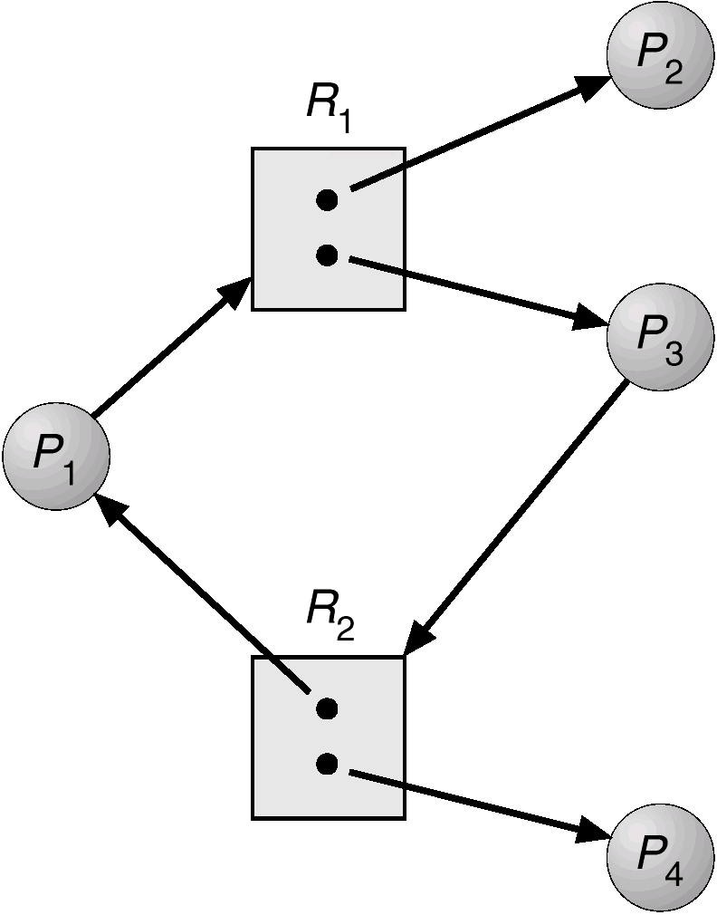
Resource Allocation Graph with deadlock Resource Allocation Graph with a cycle but no deadlock

Slide 37
How to handle deadlock
There are three kind of strategies:-
Pretend that deadlock will never happen.
Deadlock Prevention and Avoidance.
Deadlock detection and recovery.

Slide 38
Deadlock Prevention
Ensure that one of the four necessary condition of deadlock will never happen.
Mutual Exclusion:-
a) This holds for printers and other non sharable.
b) Shared entities (read only files) don't need mutual exclusion (and aren’t susceptible to deadlock.)
Prevention not possible, since some devices are intrinsically non-sharable.
Hold and wait:
a) Allocate all resources before execution.
b) A particular resource can only be requested when no others are being held.
c) Resource utilization is low, starvation possible.

Slide 39
No preemption:
a) If a process is holding some resources and requesting some resources that are not currently available then all its holding resources are preempted.
If a needed resource is held by another process, which is also waiting on some resource, then release that resource from the process and give it to needed process.
Circular wait:
Process can request resources in an increasing order of enumeration.
All resources are associated with an integer no.
Any Process Pi holding resource Ri and requesting resource Rj can only be served if F(Rj) > F(Ri).
Any Process Pi holding resource Ri and requesting resource Rj must release its resource Ri if F(Ri) > F(Rj).
Proof:- F(R0)<F(R1)<F(R2)………..<F(Rn)<F(R0)
=> F(R0)<F(R0) { That never true}
=> So circular wait will never happen.

Slide 40
Deadlock Avoidance
In deadlock avoidance additional information is kept about how resources are to be requested.
Safe State:-
It is a state of the system in which system can allocate resources to each process( upto its maximum) in some order and still avoid a deadlock.
SAFE
UNSAFE
DEADLOCK

Slide 41
There are two algorithm to avoid a deadlock:-
Resource allocation graph algorithm
Banker’s algorithm
1. Resource allocation graph algorithm:-
If Process P may request resource R then it can be indicated as claim edge P->R, when process P request then this claim edge is converted into Request edge, when resource R is released by process P then assignment edge R->P is reconverted to a claim edge P->R.
This algorithm checks if there is any cycle in the graph then system is in unsafe state.

Slide 42
2. Banker’s algorithm :-
Data structures for the Banker’s algorithm:-
Let n = number of processes, and m = number of resources types.
Available: Vector of length m. If available [j] = k, there are k instances of resource type R_{j} available
Max: n x m matrix. If Max [i,j] = k, then process P_{i} may request at most k instances of resource type R_{j}
Allocation: n x m matrix. If Allocation[i,j] = k then P_{i} is currently allocated k instances of R_{j}
Need: n x m matrix. If Need[i,j] = k, then P_{i} may need k more instances of R_{j} to complete its task Need [i,j] = Max[i,j] – Allocation [i,j]

Slide 43
Safety algorithm
1. Let Work and Finish be vectors of length m and n, respectively. Initialize:
Work = Available
Finish [i] = false for i = 0, 1, …, n- 1
2. Find an i such that both:
(a) Finish [i] = false
(b) Need_{i} ≤ Work
If no such i exists, go to step 4
3. Work = Work + Allocation_{i} Finish[i] = true go to step 2
4. If Finish [i] == true for all i, then the system is in a safe state

Slide 44
Resource-Request Algorithm for Process P_{i}
Request = request vector for process P_{i}. If Request_{i} [j] = k then process P_{i} wants k instances of resource type R_{j}
1. If Request_{i} ≤ Need_{i} go to step 2. Otherwise, raise error condition, since process has exceeded its maximum claim
2. If Request_{i} ≤ Available, go to step 3. Otherwise P_{i} must wait, since resources are not available
3. Pretend to allocate requested resources to P_{i} by modifying the state as follows:
Available = Available – Request;
Allocation_{i} = Allocation_{i} + Request_{i};
Need_{i} = Need_{i} – Request_{i};
If safe ⇒ the resources are allocated to Pi
If unsafe ⇒ Pi must wait, and the old resource-allocation state is restored

Slide 45
Example of Banker’s Algorithm
There are 5 processes P₀ P₁ P₂ P₃ P₄; and 3 resource types: A (10 instances), B (5 instances), and C ( 7 instances)
Snapshot at time T₀:
Allocation Max Available
A B C A B C A B C
P₀ 0 1 0 7 5 3 3 3 2
P₁ 2 0 0 3 2 2
P₂ 3 0 2 9 0 2
P₃ 2 1 1 2 2 2
P₄ 0 0 2 4 3 3

Slide 46
The content of the matrix Need is defined to be Max – Allocation
Need
A B C
P₀ 7 4 3
P₁ 1 2 2
P₂ 6 0 0
P₃ 0 1 1
P₄ 4 3 1
The system is in a safe state since the sequence < P₁, P₃, P₄, P₂, P₀> satisfies safety criteria

Slide 47
Example: P₁ Request (1,0,2)
Check that Request ≤ Available (that is, (1,0,2) ≤ (3,3,2) ⇒ true
Allocation Need Available
A B C A B C A B C
P₀ 0 1 0 7 4 3 2 3 0
P₁ 3 0 2 0 2 0
P₂ 3 0 2 6 0 0
P₃ 2 1 1 0 1 1
P₄ 0 0 2 4 3 1
Executing safety algorithm shows that sequence < P₁, P₃, P₄, P₀, P₂> satisfies safety requirement
Can request for (3,3,0) by P₄ be granted?
Can request for (0,2,0) by P₀ be granted?

Slide 48
Deadlock Detection and Recovery
Allow system to enter deadlock state
Detection algorithm
Recovery scheme

Slide 49
Single Instance of Each Resource Type
Maintain wait-for graph
Nodes are processes
P_{i} → P_{j} if P_{i} is waiting for P_{j}
Periodically invoke an algorithm that searches for a cycle in the graph. If there is a cycle, there exists a deadlock
An algorithm to detect a cycle in a graph requires an order of n² operations, where n is the number of vertices in the graph

Slide 50
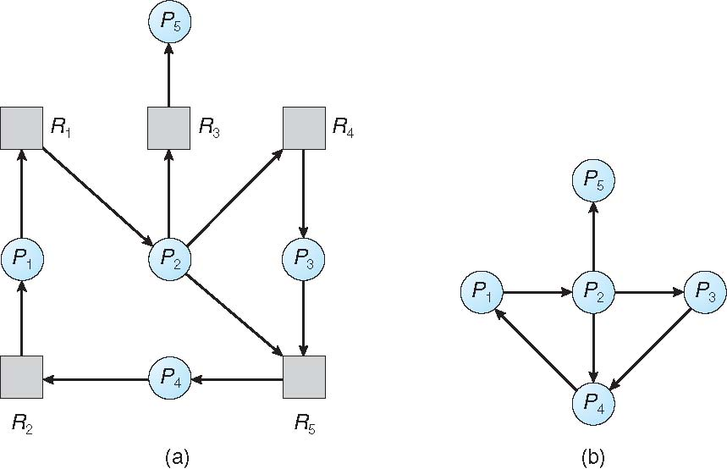
Resource-Allocation Graph and Wait-for Graph
Resource-Allocation Graph
Corresponding wait-for graph

Slide 51
Several Instances of a Resource Type
Available: A vector of length m indicates the number of available resources of each type.
Allocation: An n x m matrix defines the number of resources of each type currently allocated to each process.
Request: An n x m matrix indicates the current request of each process. If Request [i][j] = k, then process P_{i} is requesting k more instances of resource type.R_{j}.

Slide 52
Detection Algorithm
1. Let Work and Finish be vectors of length m and n, respectively Initialize:
(a) Work = Available
(b) For i = 1,2, …, n, if Allocation_{i} ≠ 0, then Finish[i] = false; otherwise, Finish[i] = true
2. Find an index i such that both:
(a) Finish[i] == false
(b) Request_{i} ≤ Work
If no such i exists, go to step 4
3. Work = Work + Allocation_{i} Finish[i] = true go to step 2
If Finish[i] == false, for some i, 1 ≤ i ≤ n, then the system is in deadlock state. Moreover, if Finish[i] == false, then P_{i} is deadlocked

Slide 53
Example of Detection Algorithm
Five processes P₀ through P₄; three resource types A (7 instances), B (2 instances), and C (6 instances)
Snapshot at time T₀:
Allocation Request Available
A B C A B C A B C
P₀ 0 1 0 0 0 0 0 0 0
P₁ 2 0 0 2 0 2
P₂ 3 0 3 0 0 0
P₃ 2 1 1 1 0 0
P₄ 0 0 2 0 0 2
Sequence <P₀, P₂, P₃, P₁, P₄> will result in Finish[i] = true for all i

Slide 54
Example (Cont.)
P₂ requests an additional instance of type C
Request
A B C
P₀ 0 0 0
P₁ 2 0 2
P₂ 0 0 1
P₃ 1 0 0
P₄ 0 0 2
State of system?
Can reclaim resources held by process P₀, but insufficient resources to fulfill other processes; requests
Deadlock exists, consisting of processes P₁, P₂, P₃, and P₄

Slide 55
Recovery from Deadlock: Process Termination
Abort all deadlocked processes
Abort one process at a time until the deadlock cycle is eliminated
In which order should we choose to abort?
Priority of the process
How long process has computed, and how much longer to completion
Resources the process has used
Resources process needs to complete
How many processes will need to be terminated
Is process interactive or batch?

Slide 56
Recovery from Deadlock: Resource Preemption
Selecting a victim – minimize cost
Rollback – return to some safe state, restart process for that state
Problem: starvation – same process may always be picked as victim, include number of rollback in cost factor

Slide 57

Thank You!!

